Slide 1


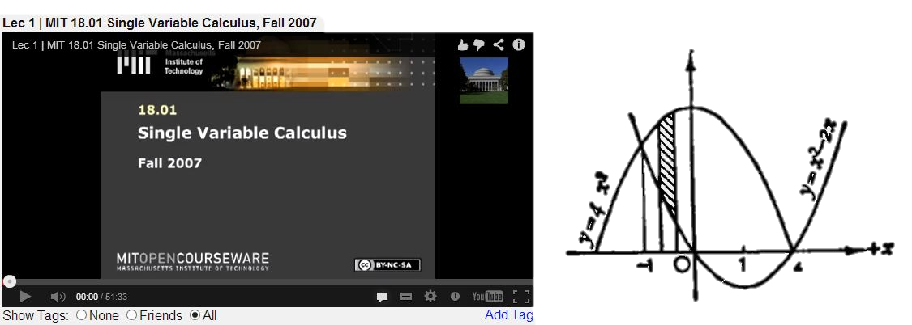
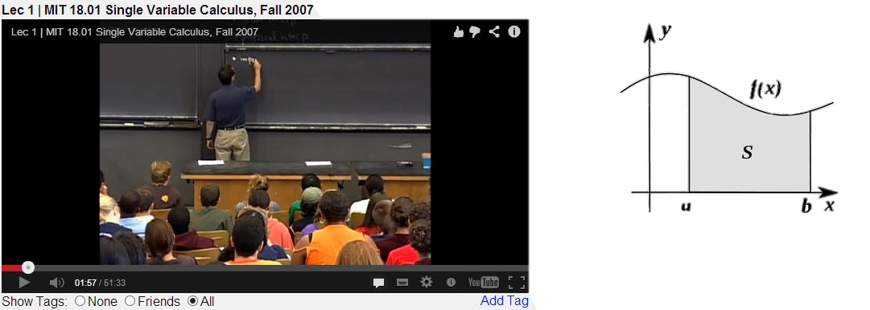
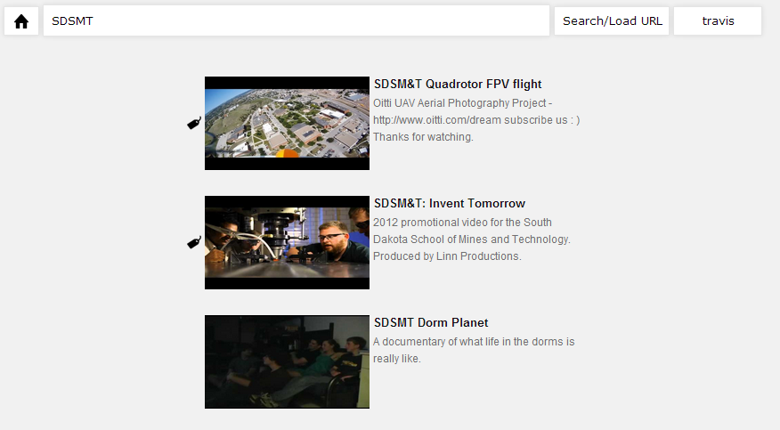
Video Tag Portal
Anudeep Potlapally and Travis Rous
Project Overview
User defined tags appear as the video plays.
How It Works
This application is one where the users are allowed to add “that something” that is missing from a video of their choosing and share it with the world. For example adding pictures to an online lecture.
Using accounts that you already have, you can create videos with tags, upload videos, and see videos that your friends have added to their favorites. The tags are then stored on our local database.
Features
Plays videos from YouTube and Vimeo
Able to upload videos from the site to YouTube
Allow you to see the friends that are also using the application.
Able to add tags at any point in the video
Available tags:
Comments
Images
Hyperlinks
Maps
Tag Filters
See everyone’s tags or just your friend’s
Origination
The idea was originally proposed by Nick Newell from EchoStar.
Nick noticed that many imaging sites would allow you to add comments and links to still images. However there was no way to easily do this for videos.
Search videos to add your own tags or just to watch.
Development Tools
PHP
JavaScript
HTML5
jQuery
MySQL
Popcorn.js
Google and FaceBook API’s
Notepad++
Acknowledgments
Jeff McGough
Brian Butterfield
Nick Newell

